Slide 1

Code +

Slide 2
Today
What is an expression?
Why are expressions important?
How we use expressions?
Code +

Slide 3
Expression
A bit of mathematics
10
(5+5)
15 + 10
15 + (5+5)
25
Code +
Any difference?

Slide 4
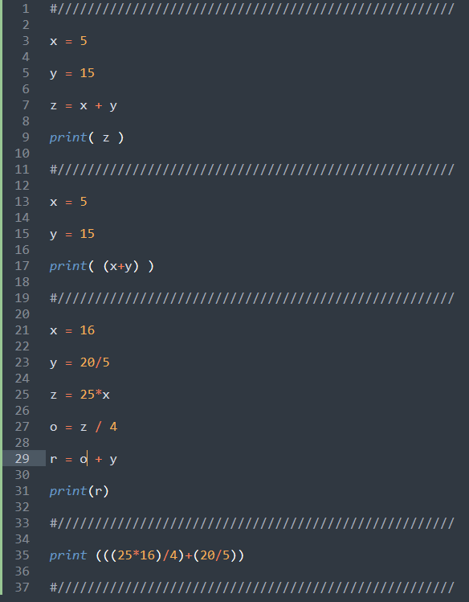
Expressions
Save space
Harder to read
Save time
Code +

Slide 5
Expression
Code +

